Slide 1
ES6 Modules
Mr. Anbuselvan Annamalai
www.anbuselvan-annamalai.com
ESM vs CJS
- தமிழில்
PART OF MODERN JAVASCRIPT SERIES

Slide 2

🕰️ A Bit of History:
Before 2009: JavaScript was mostly used in browsers, and there was no standard module system.
In 2009, the CommonJS project (initially called ServerJS) was started to bring modularity to JavaScript outside the browser, especially for server-side use.
Node.js adopted CommonJS as its default module system when it launched in 2009.

Slide 3
Developers found some ways…
AMD – one of the most ancient module systems, initially implemented by the library require.js.
CommonJS – the module system created for Node.js server.
UMD – one more module system, suggested as a universal one, compatible with AMD and CommonJS.

Slide 4
What is a module? (ESM)
A module is just a file. One script is one module.
ESM, short for ECMAScript Module, is the official, standardized way to write modular JavaScript introduced in ES6 (ECMAScript 2015).
ESM lets you break your code into separate files and reuse or share functionality by importing/exporting code between those files — cleanly and safely.

Slide 5
Problems before ES6 Modules
Global Namespace Pollution
In older JS (before ES6), all variables/functions were dumped into the global scope.
This led to variable conflicts:
No Built-in Modular System
Developers had to use IIFEs or custom module loaders (like RequireJS) to simulate modularity.
It was hacky, inconsistent, and non-standard.
Poor Code Organization
Hard to manage large codebases when everything was in one file.
Dependencies between files weren’t clear.
Debugging and maintenance were harder.

Slide 6
✅ What ES6 Modules Solve
Scoped Variables (No Global Leaks)
Code inside a module is scoped — variables/functions don’t leak into the global space.
Built-in Modular System
Standard import and export syntax — no need for third-party tools just to modularize code.
Clear Dependency Management
Each file explicitly states its dependencies. js
Better Code Reusability
You can build reusable functions/components and share them across multiple projects.
Improved Maintainability
Easy to locate and edit functionality. Smaller, focused files instead of one large script.
Tree Shaking (in bundlers)
Only the used parts of a module get included in the final bundle, reducing file size.

Slide 7
Benefits of ES6 Modules:
Code Organization and Reusability: Facilitates breaking down large applications into smaller, manageable, and reusable units.
Dependency Management: Makes dependencies explicit, improving code clarity and maintainability.
Reduced Global Scope Pollution: Prevents variables and functions from polluting the global namespace.
Improved Readability and Maintainability:
Promotes a more structured and modular approach to JavaScript development.

Slide 8
Export & import
import Statement:
The import keyword is used to bring exported values from other modules into the current module.
Importing Named Exports:
Requires using curly braces and the exact names of the exported items.
Importing Default Exports:
Allow exporting a single, primary value from a module. There can only be one default export per module.
export Statement:
The export keyword is used to make specific values (variables, functions, classes) available for use in other modules.
Named Exports:
Allow exporting multiple items by name.
Default Exports: Allow exporting a single, primary value from a module. There can only be one default export per module.

Slide 9
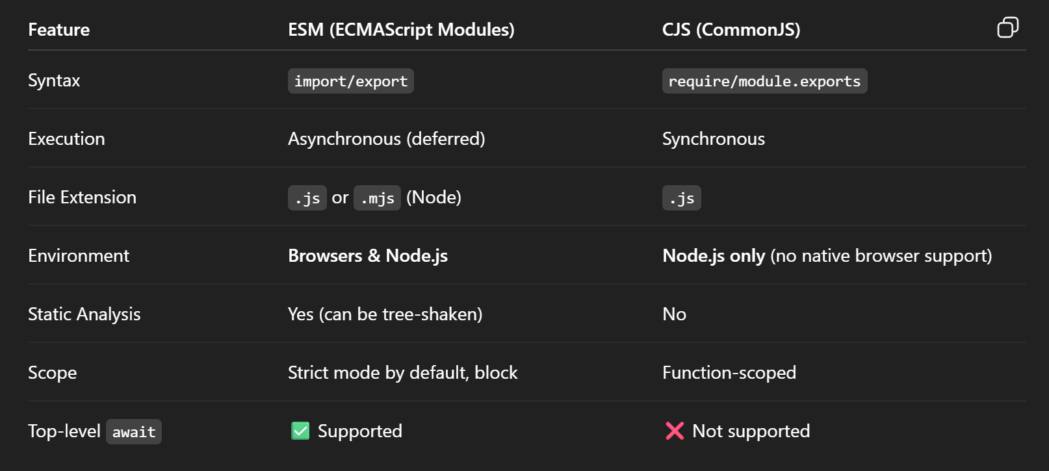
🧠 Core Differences: ESM vs CJS

